Slide 1
Writing
PowerPoint Cues
Turn and Talk
Active Listening
Silent Solo
Class Discussion
Document Camera

Slide 2
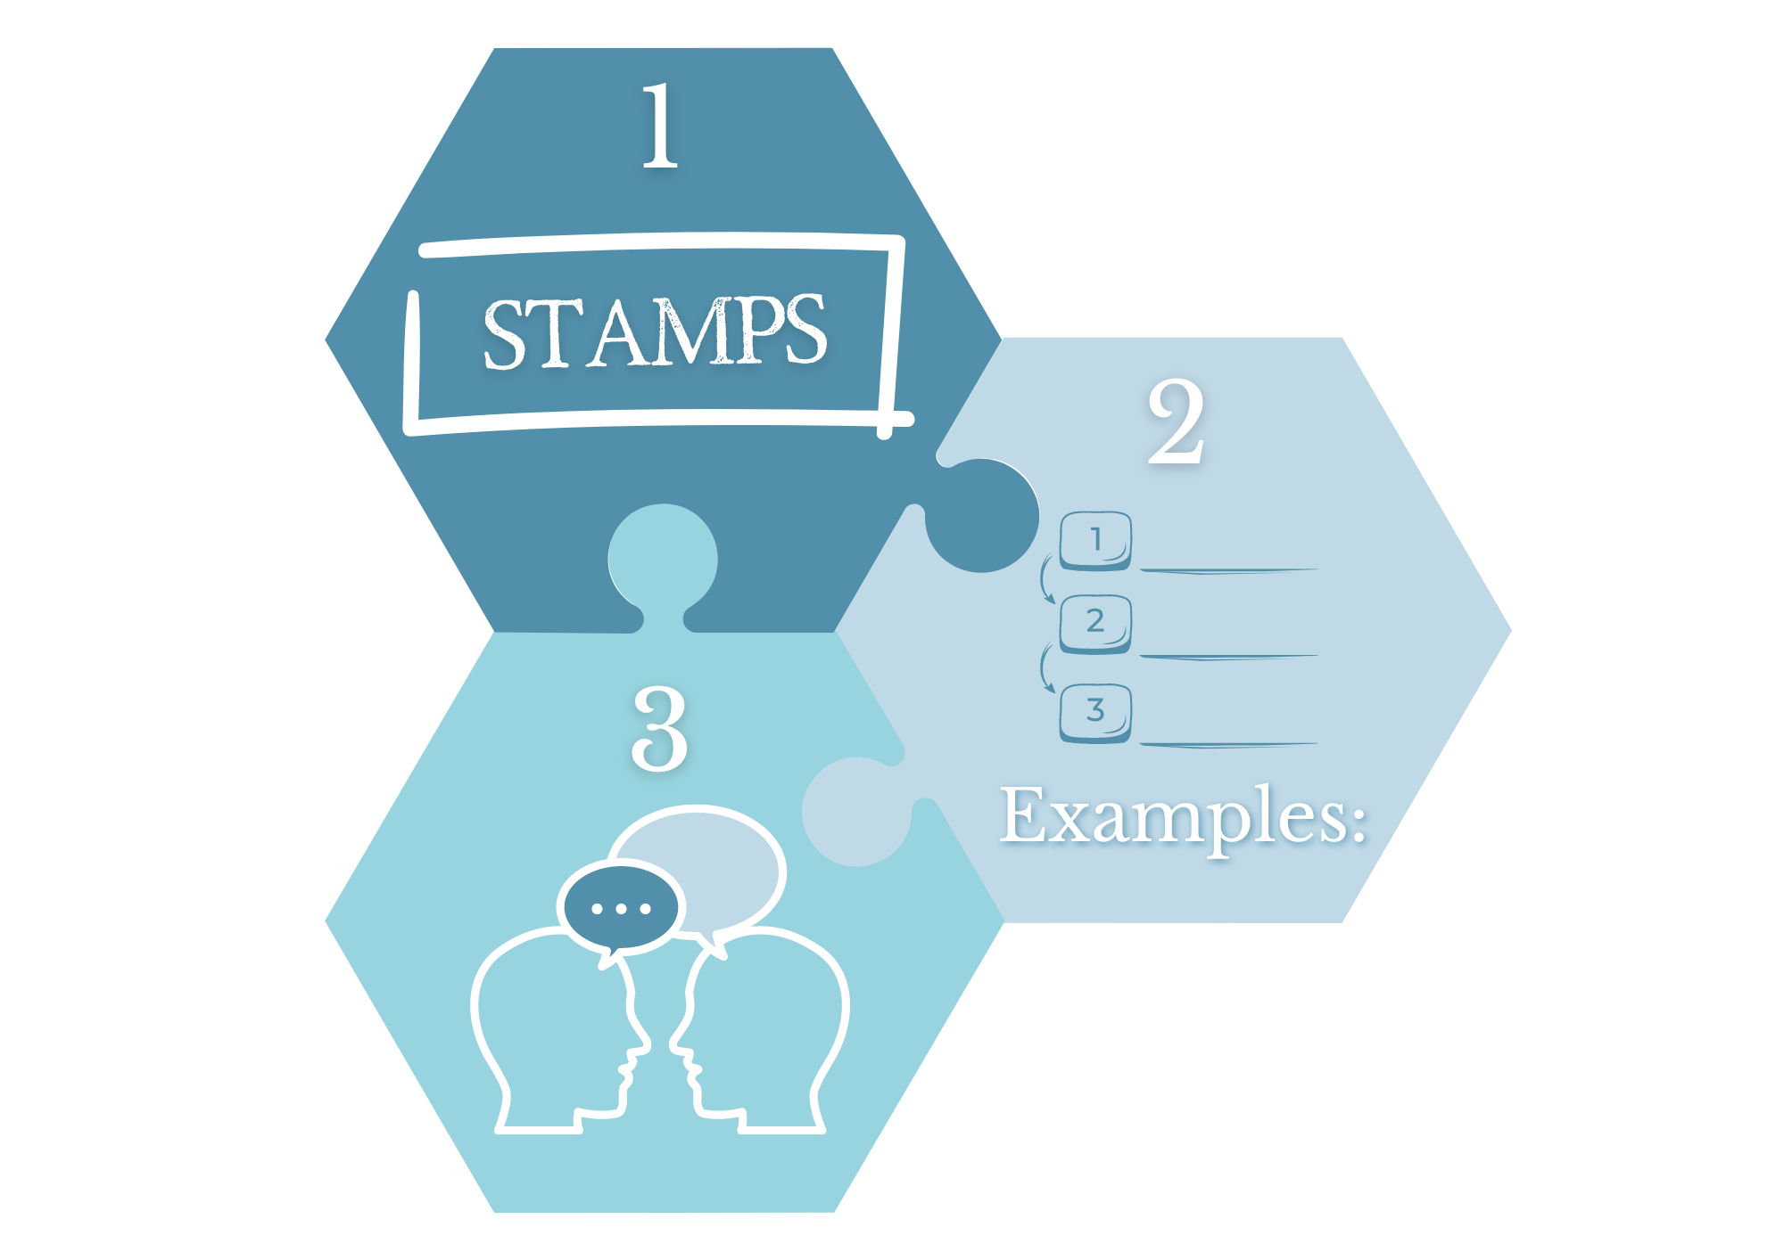
Non-Verbal Participation
iPad
3 Before Me
All Hands

Slide 3
Show Call
Stamp It
Poll
Cold Call
Everybody Writes
Choral Response

Slide 4
Seating Plan
Teacher’s Desk
WHITEBOARD
Back of Room
Door

Slide 5
Seating Plan
Teacher’s Desk
WHITEBOARD
Back of Room
Door

